Slide 1



Advantages and Disadvantages Essay
IELTS COURSE
And how to write it?

Slide 2


Look at the essay and answer the following questions
What is an essay?
What type of an essay is this?
What is the register of the essay?
What is the structure of the essay?
Can you use contractions / personal pronouns in the essay?

Slide 3
ESSAY
a piece of writing that is written to convince someone of something or to simply inform the reader about a particular topic.

Slide 4
Essays can be different
Opinion essay
Advantages and disadvantages

Slide 5
Essays can be different
Opinion essay
Advantages and disadvantages

Slide 6
The examples of tasks:
What are the advantages and disadvantages of….?
Do you think the advantages outweigh the disadvantages?
Discuss the advantages and disadvantages and give your opinion.

Slide 7



Look at the following pieces of texts. Put them in the correct order and describe what you should write in each paragraph.

Slide 8


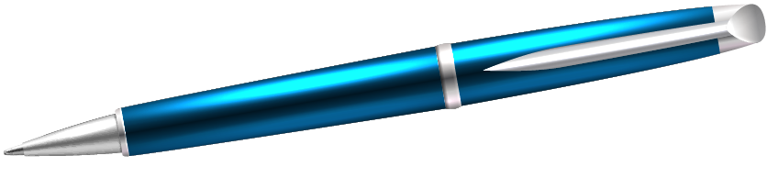

01
Introduction

Slide 9
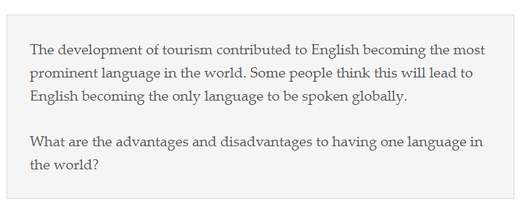

Slide 10
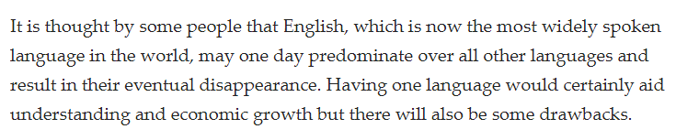

Slide 12
Rephrase the task

Slide 13
Rephrase the task

Slide 14
Rephrase the task
Outline main ideas briefly (advantage + disadvantage)

Slide 15
Rephrase the task
Outline main ideas briefly (advantage + disadvantage)
State your opinion (if necessary)

Slide 16
02
Main body

Slide 17
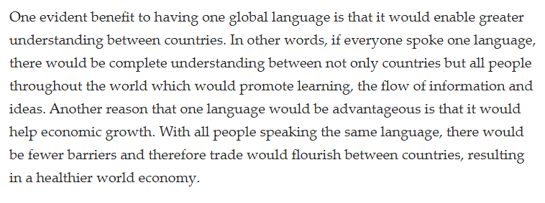

Slide 18
Topic sentence – introduce the first advantage

Slide 19
2. ?

Slide 20
2. Explain in detail and give an example

Slide 21
The rest?

Slide 22


Slide 24
Topic sentence – introduce the problem

Slide 26
2. State the first disadvantage

Slide 28
3. Explain and give examples

Slide 30
4. The second disadvantage + explanation and examples

Slide 31


03
Conclusion

Slide 32
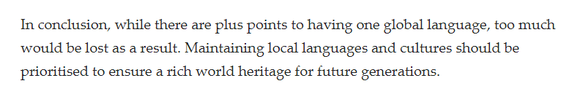

Slide 34
Summarise the key points (1-2 sentences)

Slide 35
Summarise the key points (1-2 sentences)

Slide 36
Summarise the key points (1-2 sentences
Provide your opinion (if necessary)

Slide 37



Structure of the essay (full)

Slide 38
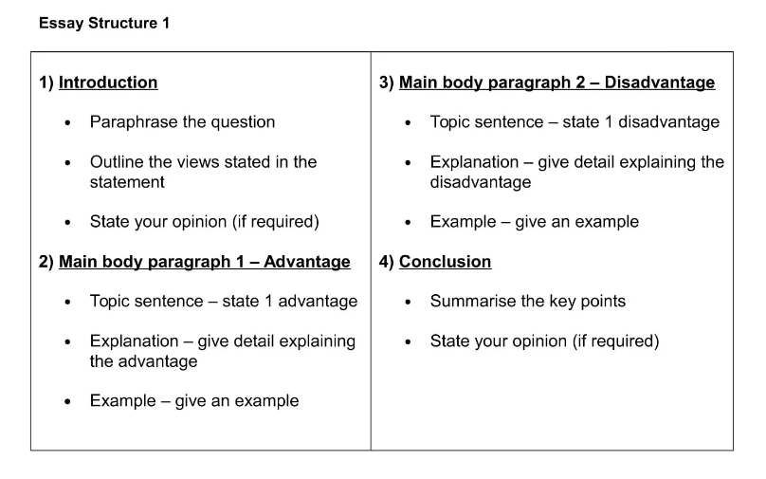

Slide 39
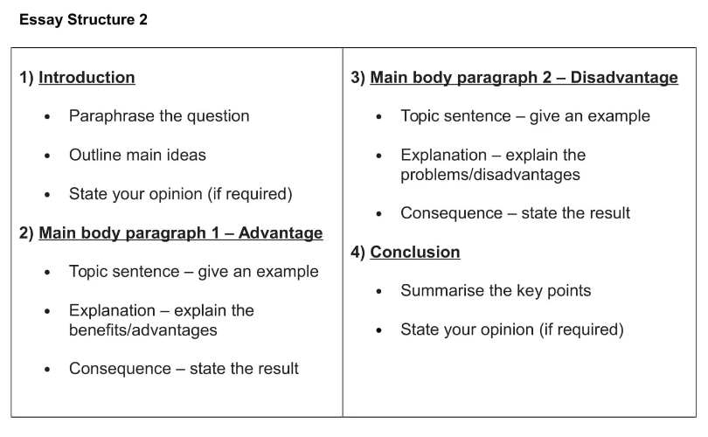

Slide 40
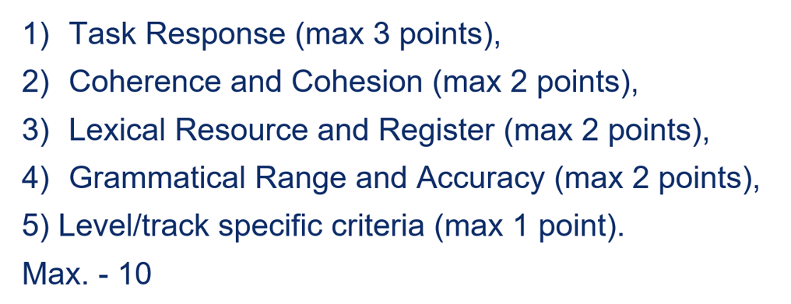
Criteria

Slide 41
Any questions?

Slide 42
How many words should you write?

Slide 43
How many words should you write? - 250-300 words

Slide 44
Should you use vocabulary from Student’s book?

Slide 45
Should you use vocabulary from Student’s book? - yes

Slide 46
Can you mention only one advantage and one disadvantage? - yes, but it should be informative, and it would be more difficult to get enough words

Slide 47
Should you introduce new ideas in a conclusion?

Slide 48
Should you introduce new ideas in a conclusion? - NO!!!!!

Slide 49
What can you do if you have less than 250 words?

Slide 50
You can write 1 sentence with recommendation in a conclusion or provide more details for your advantages and disadvantages

